Slide 1
Chapter 10: Boiling and Condensation
Latent heat exchange involving change of phase (h_{fg} = 2.40 × 10⁶ J/kg or 1040 Btu/lb for water).
Boling: Liquid → Vapor; Condensation: Liquid ← Vapor
Applications:
Engineering applications involving high heat fluxes. Typical applications include closed-loop power cycles, vapor-compression refrigeration cycles, and thermal management of advanced electronics equipments.
Boiling Modes:
When evaporation occurs at a solid-liquid interface, it is termed boiling. The boiling occurs when the temperature of the surface exceeds the saturation temperature corresponding to the liquid pressure. The Newton’s law of cooling may be still used:

Slide 2
Boiling Heat Transfer
The boiling process is characterized by the formation of the vapor bubble, which grow and subsequently detach from the surface. The large heat transfer rate is due primarily to the vapor formation (latent heat) and agitation of the liquid pool by the bubbles as they ascend from the wall.
Types of boiling:
Pool boiling
Forced convection boiling
Also be classified as:
Subcooled boiling in which the temperature of the liquid is below the saturation temperature and the bubble formed at the surface may be condensed in the liquid.
Saturated boiling, in which the temperature of the liquid slightly exceeds the saturation temperature

Slide 3
Boiling Curves

Slide 4
Boiling Curves (temperature controlled)
Vary the temperature of the heat transfer surface while allowing the heat transfer rate to change –temperature control mode through condensing steam in a tube at different pressures.

Slide 5
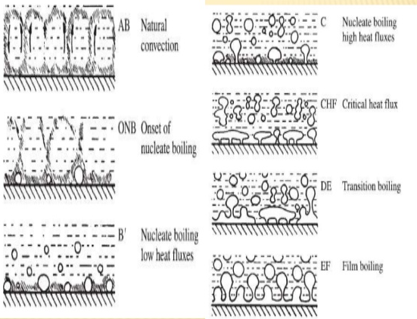
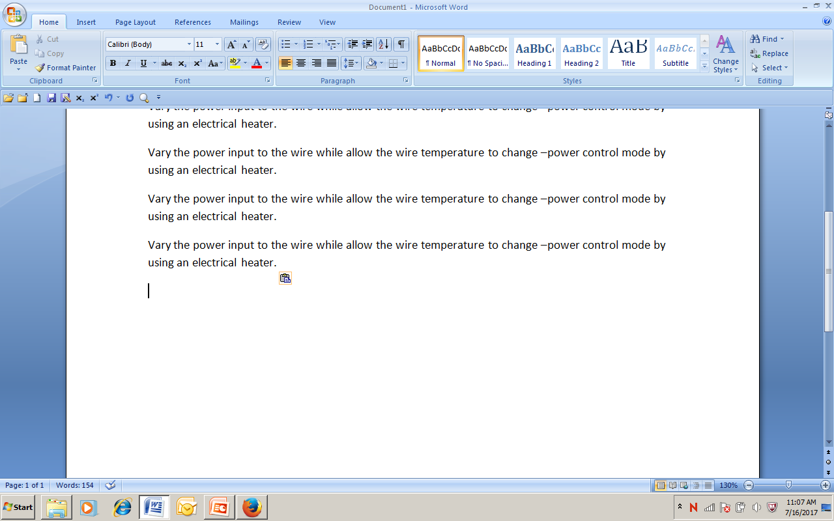
Boiling Modes (Google)

Slide 6
Boiling Curves (power controlled)

Slide 7
Boiling Curves (power controlled)
Vary the power input to the wire while allow the wire temperature to change –power control mode by using an electrical heater.
Since most practical applications involve the power varying mode , the maximum heat flux is a matter of great importance.

Slide 8
Boiling Heat Transfer Enhancement
Enhancement surfaces include: (1) coating of very porous material formed by sintering, brazing, flame spraying, electrolytic deposition, or foaming , and (2) mechanically machined or formed double reentrant cavities to ensure continuous vapor trapping.
These surfaces provide for continuous renewal of vapor at the nucleation sites and heat transfer augmentation by more than an order of magnitude.

Slide 9
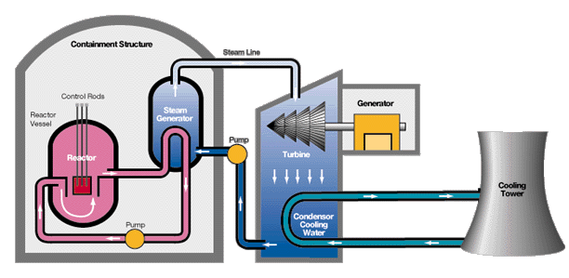
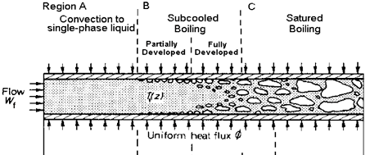
Flow Boiling for Industrial Applications (Google images)
The fluid may be highly pressurized.

Slide 10
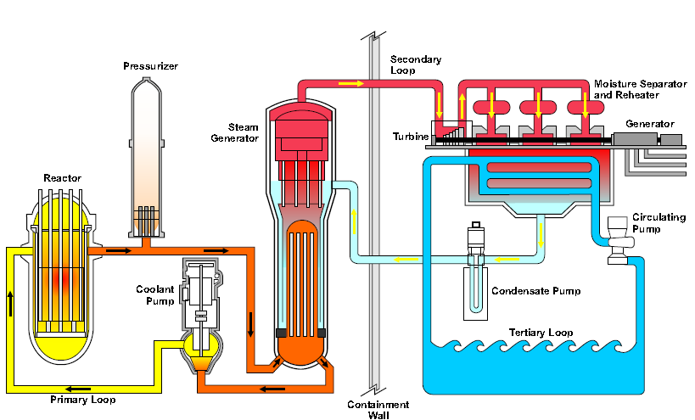
Flow Boiling for Industrial Applications (Google images)

Slide 11
Condensation Heat Transfer

Slide 12
Laminar Film Condensation on a Vertical Plate

Slide 13
Laminar Film Condensation on a Vertical Plate – Nusselt Solution

