Slide 1
EEL 6443: Electro-Optical Devices and Systems
Summer 2010
Dr. Jean Andrian

Slide 2
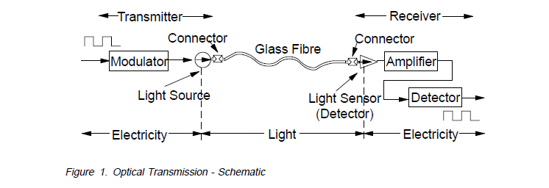

Slide 3
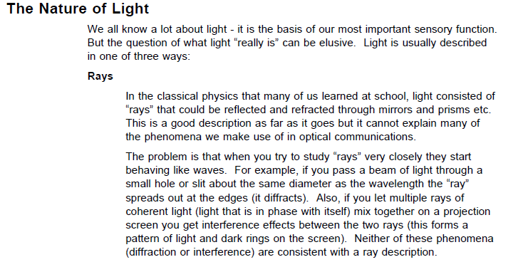

Slide 4
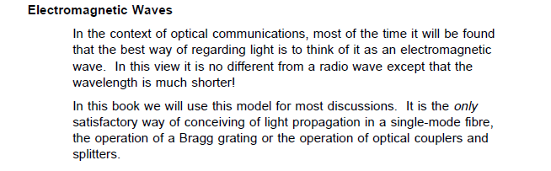

Slide 5
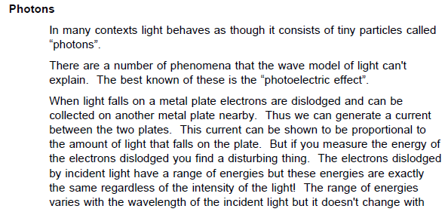

Slide 6
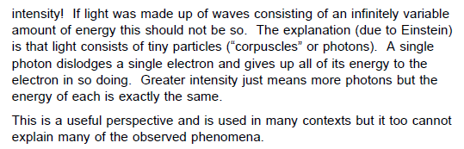

Slide 7
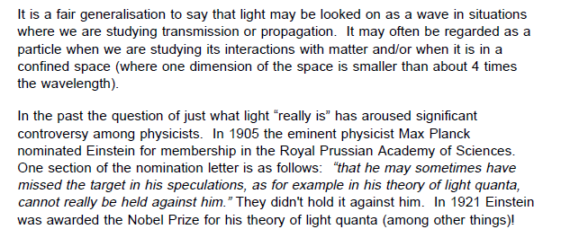

Slide 8
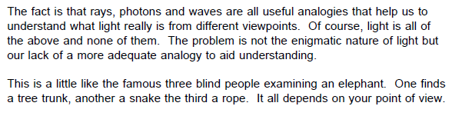

Slide 9
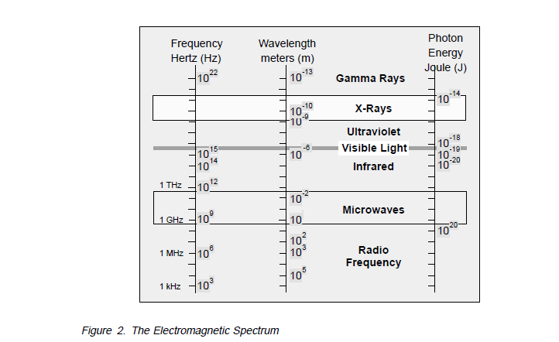

Slide 10
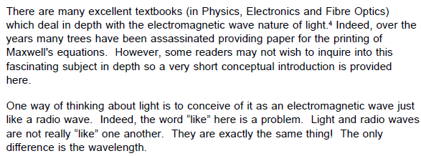

Slide 11
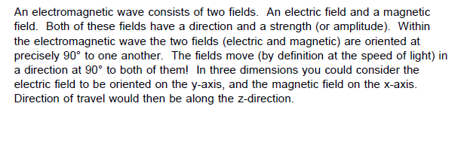

Slide 12
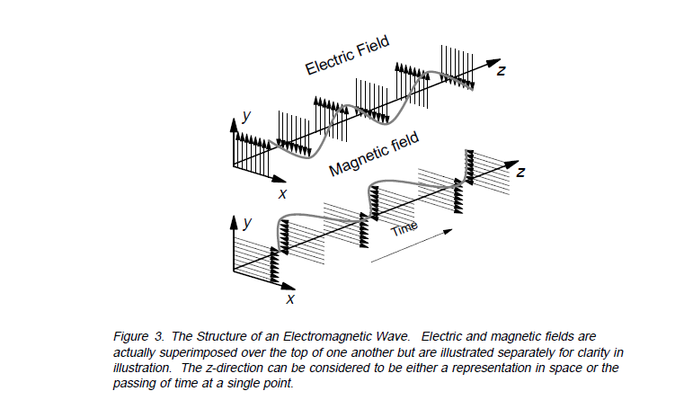

Slide 13
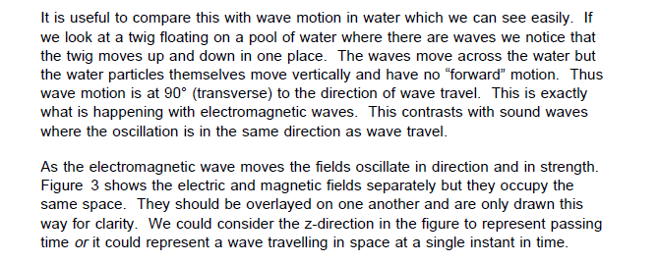

Slide 14
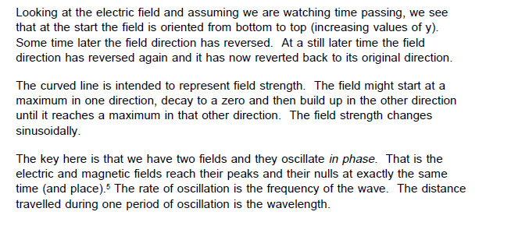

Slide 15
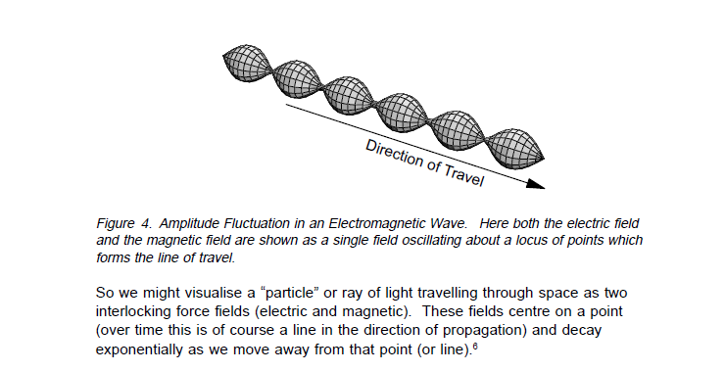

Slide 16
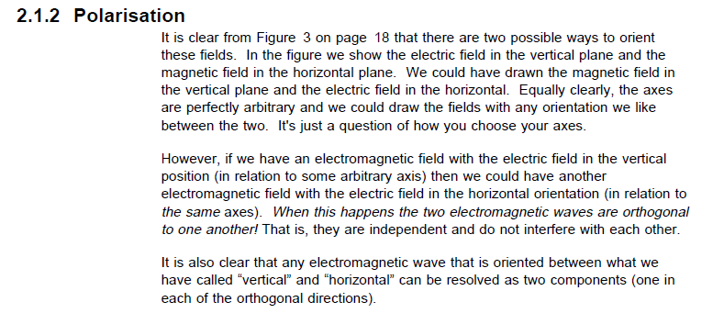

Slide 17
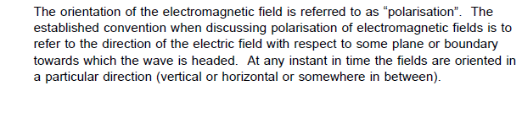

Slide 18
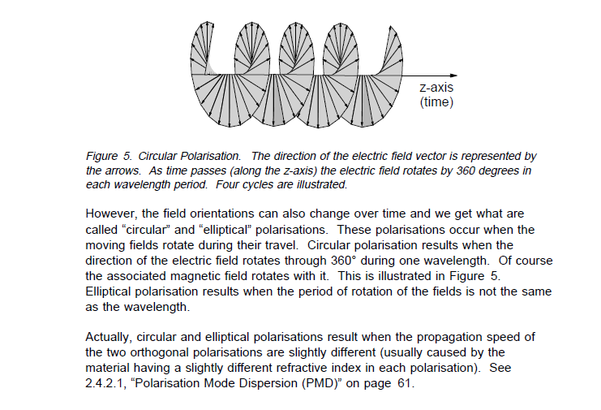

Slide 19
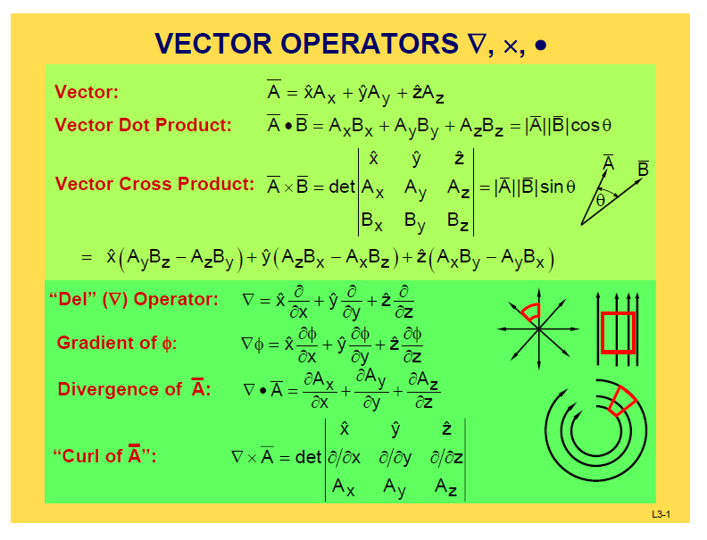

Slide 20
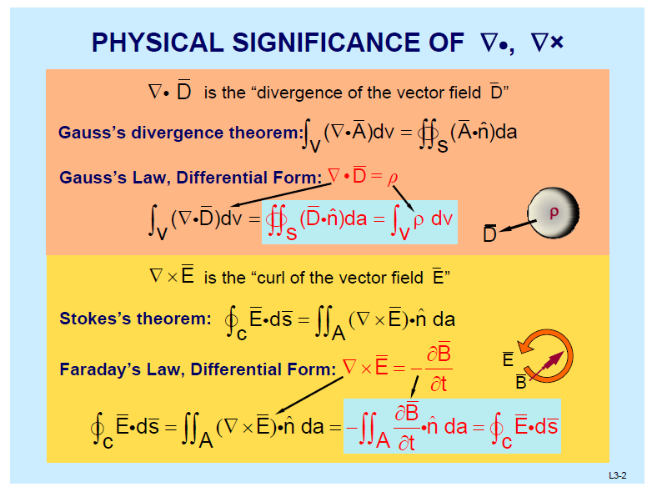

Slide 21
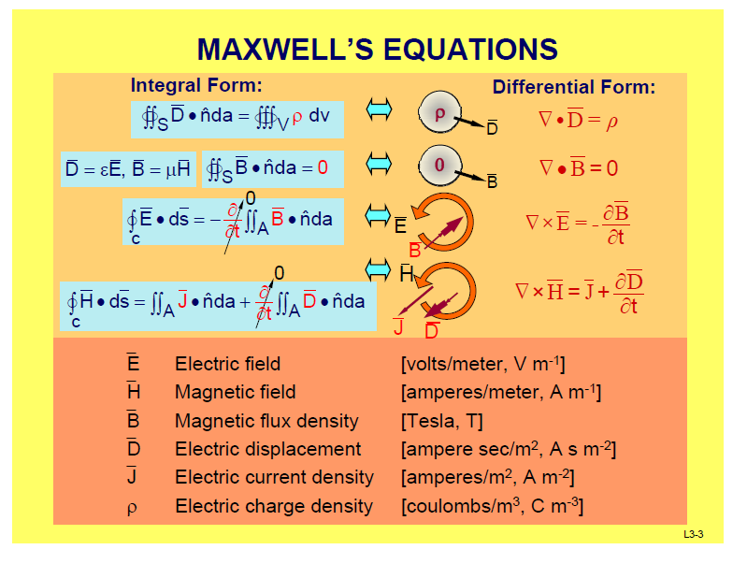

Slide 22
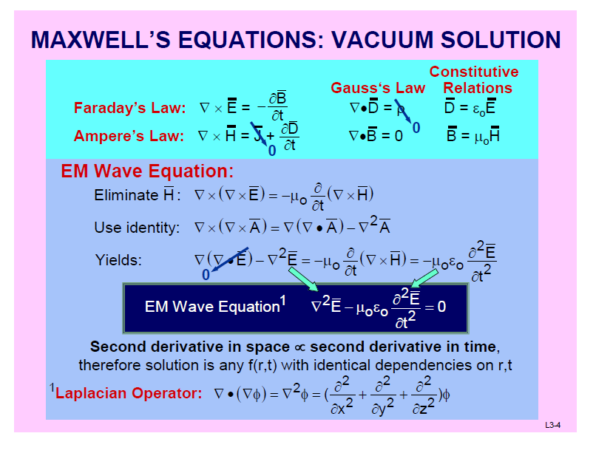

Slide 23
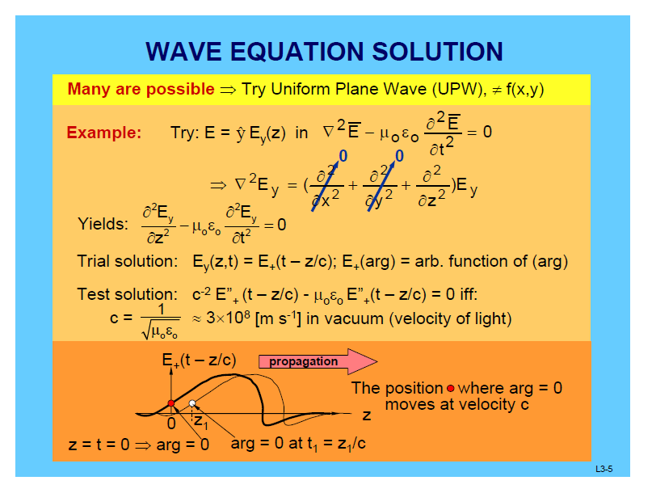

Slide 24
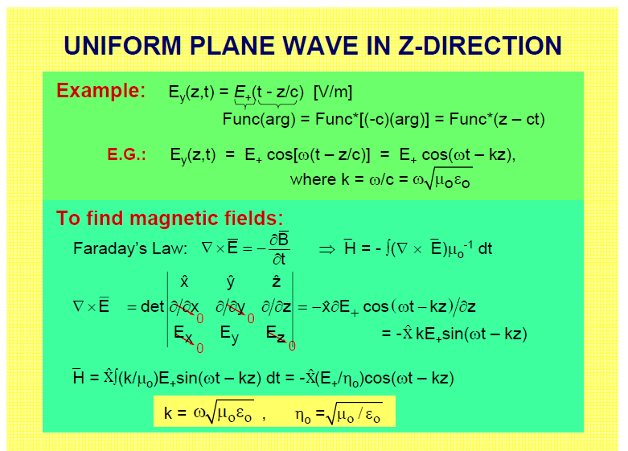

Slide 25
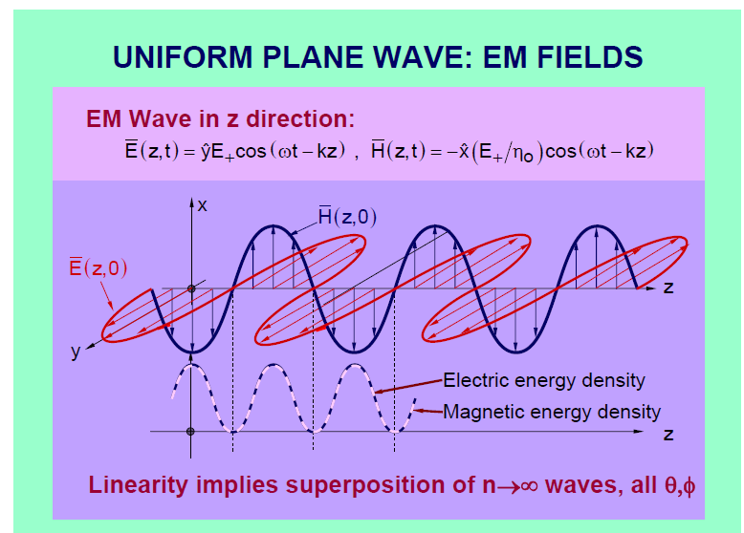

Slide 26
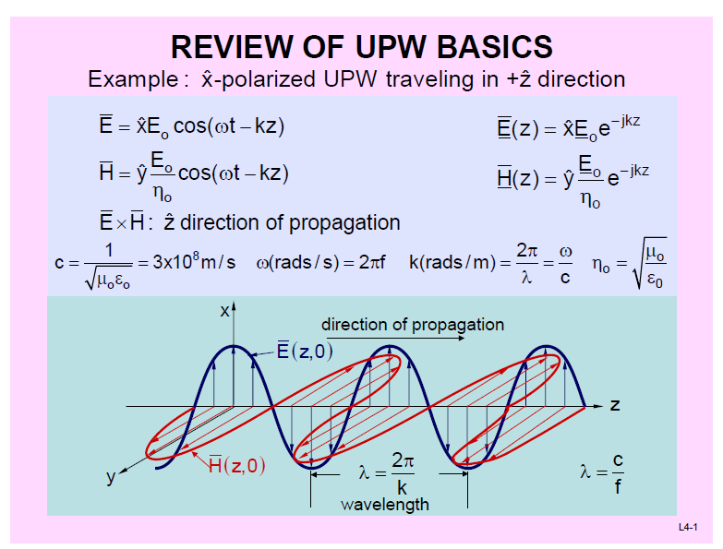

Slide 27
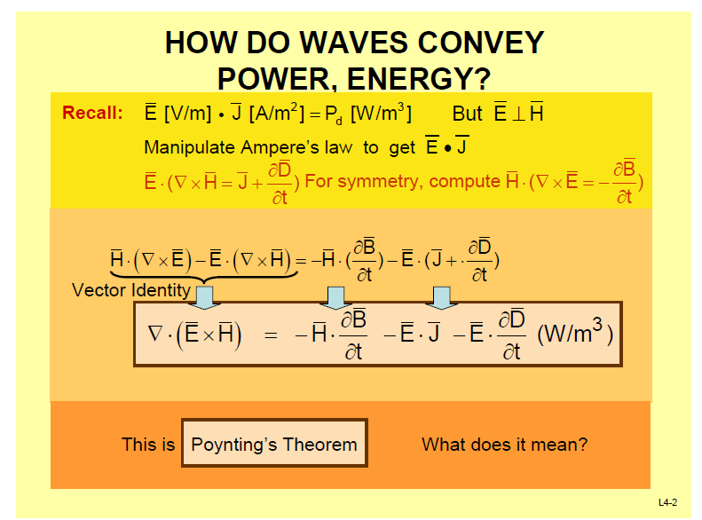

Slide 28
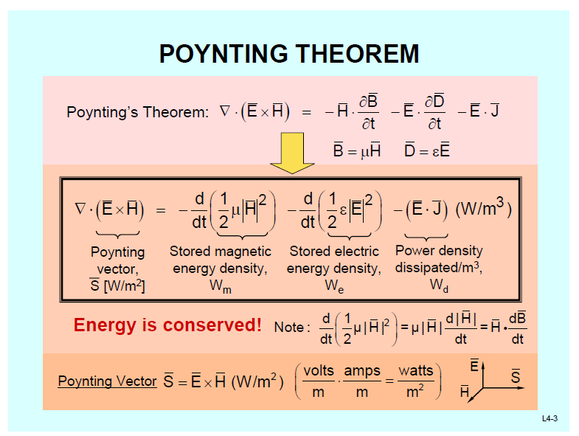

Slide 29
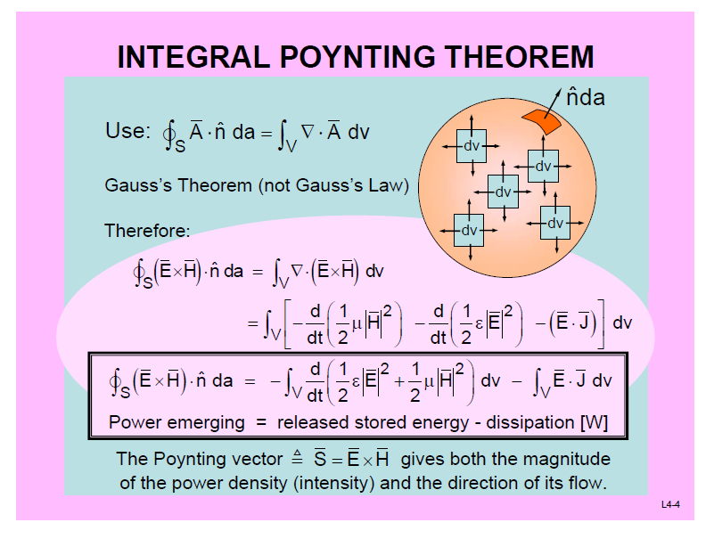

Slide 30
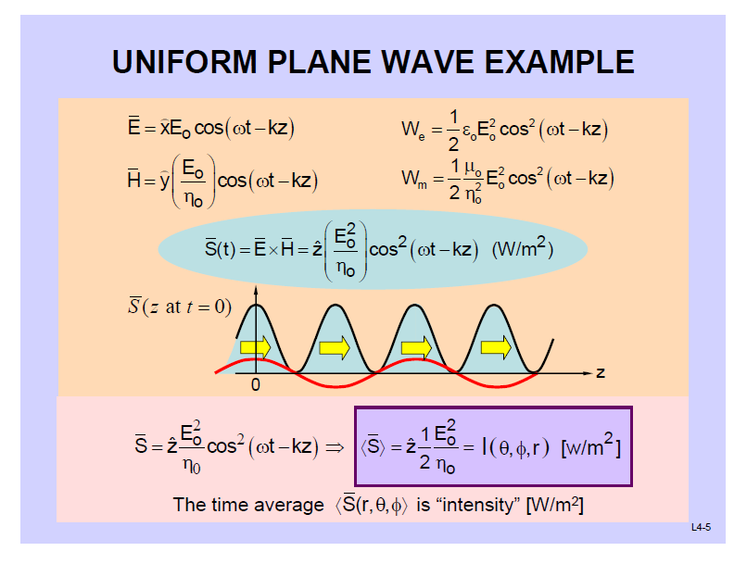

Slide 31
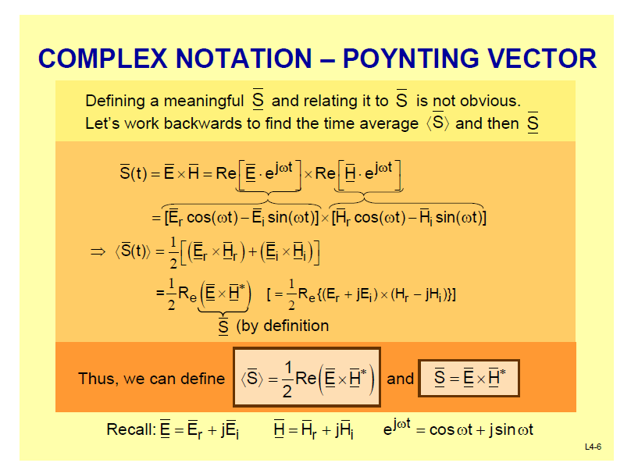

Slide 32
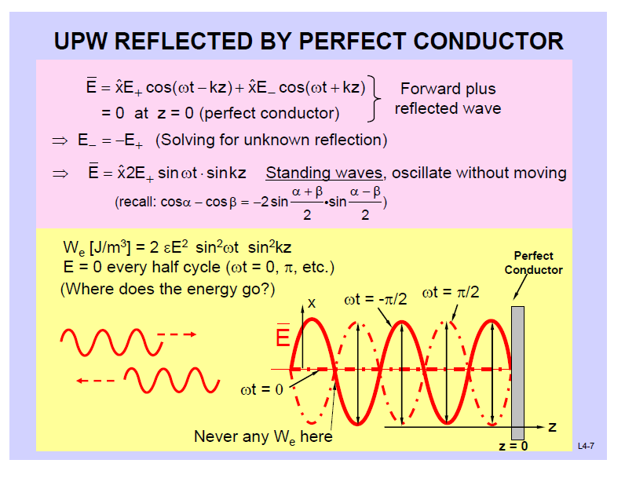

Slide 33
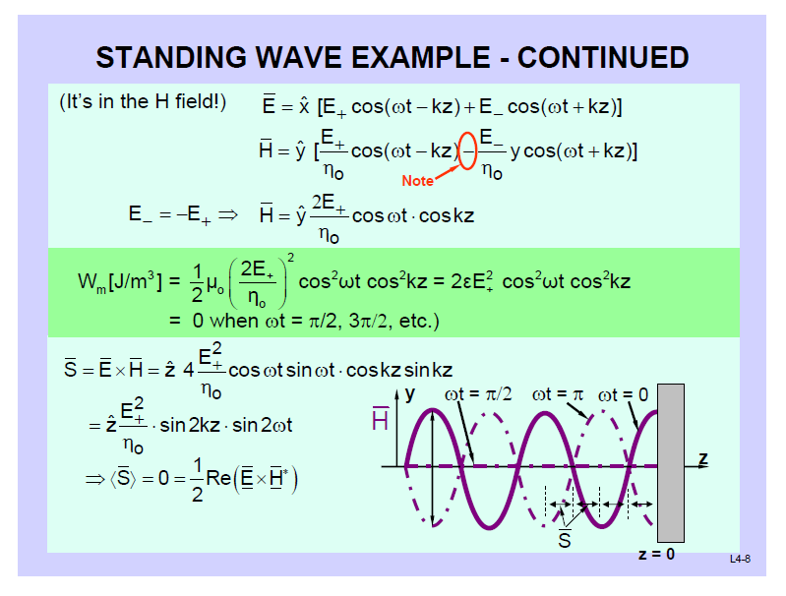

Slide 34
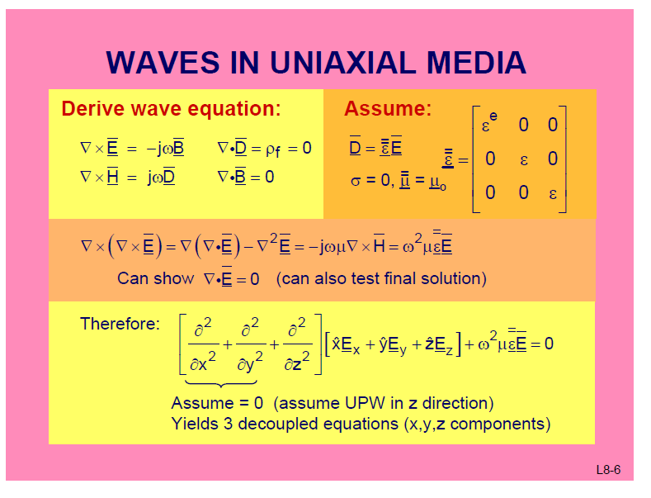

Slide 35
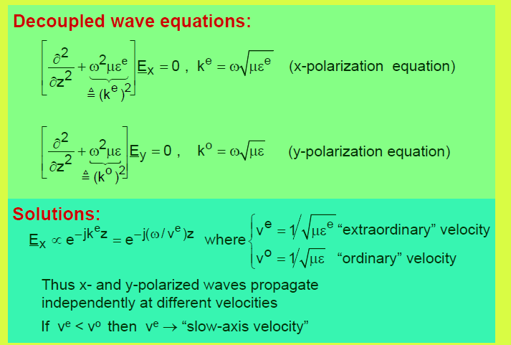

Slide 36
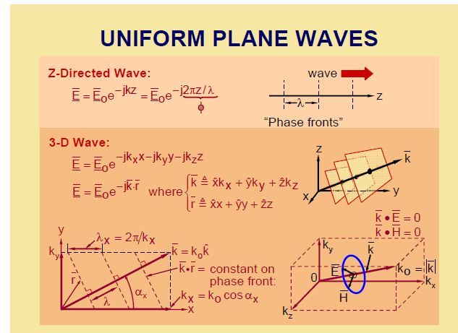

Slide 37
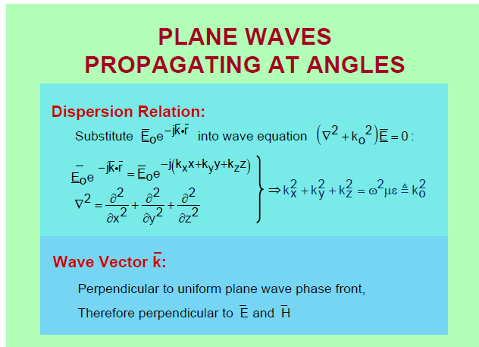

Slide 38
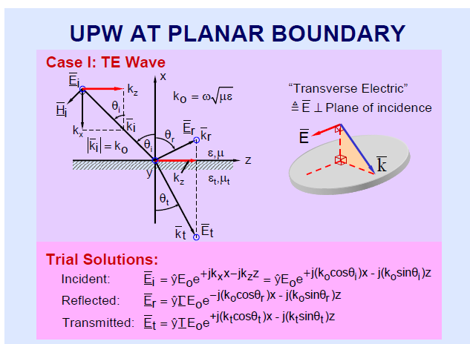

Slide 39
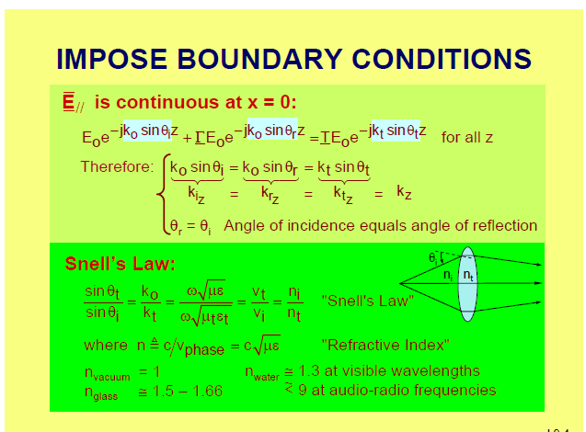

Slide 40
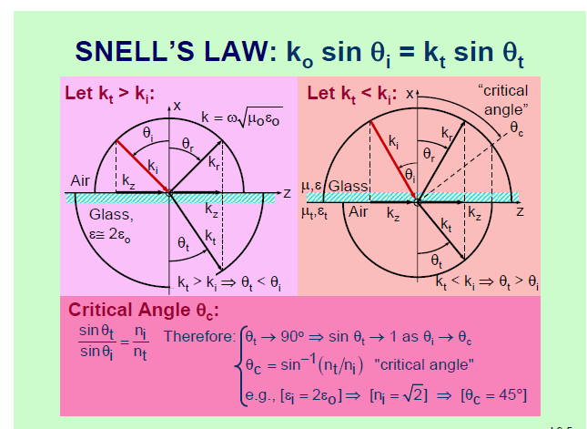

Slide 41
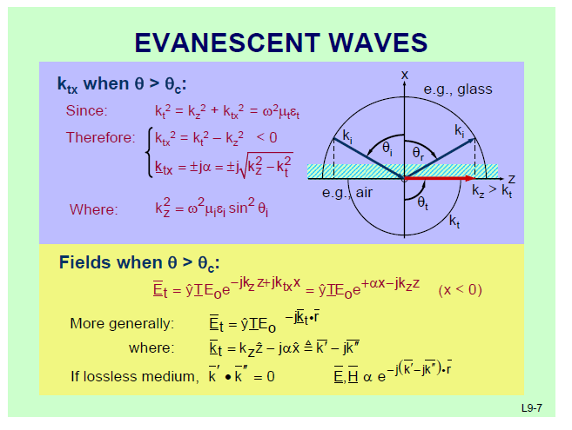

Slide 42
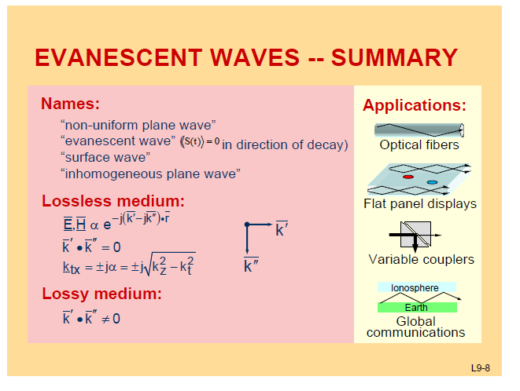

Slide 43
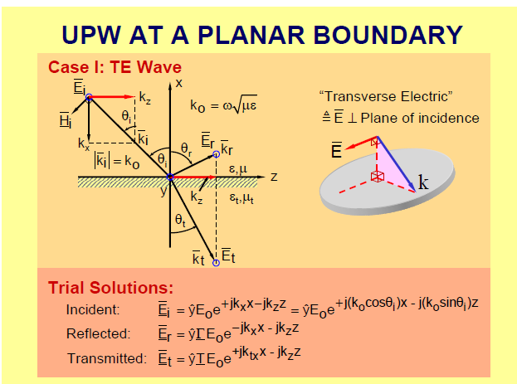

Slide 44
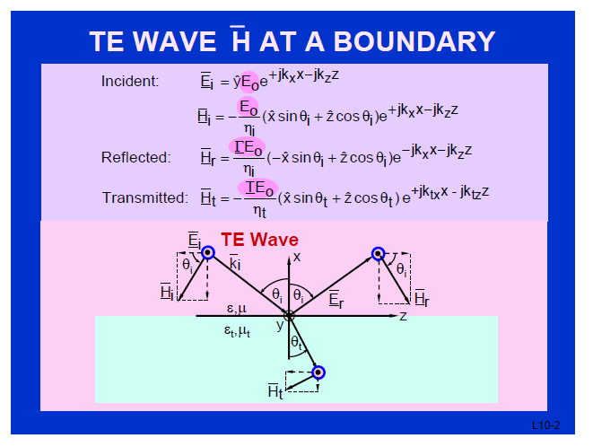

Slide 45
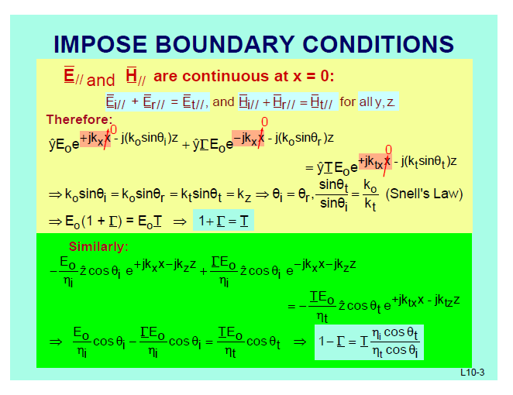

Slide 46
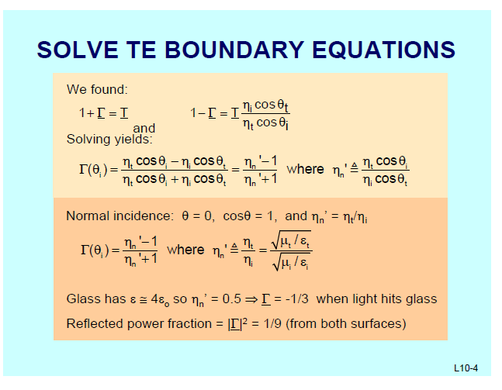

Slide 47
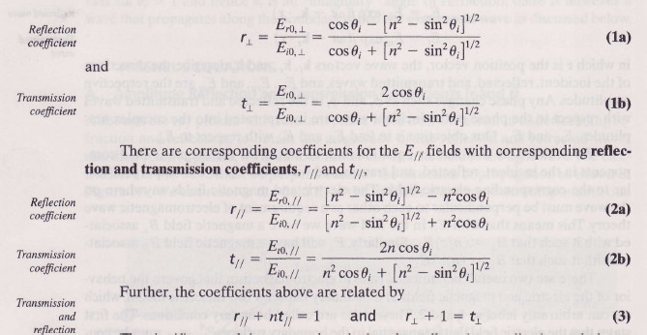

Slide 48
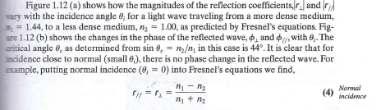

Slide 49
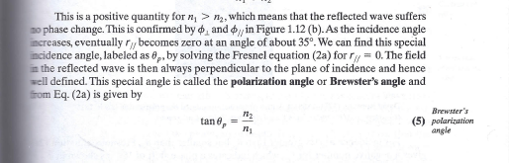

Slide 51
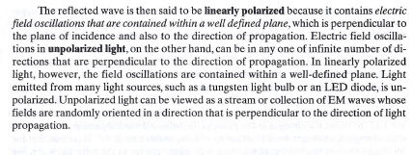

Slide 52
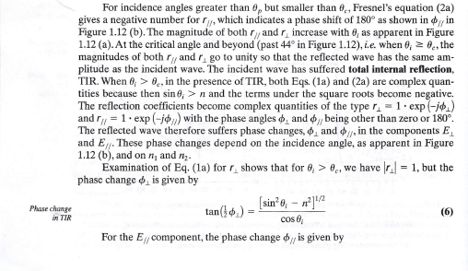

Slide 53


Slide 54


Slide 55


Slide 57


Slide 58


Slide 59


Slide 60


Slide 61


Slide 63


Slide 64


Slide 66


Slide 67


Slide 69


Slide 70


Slide 71


Slide 73


Slide 74


Slide 75


Slide 76


Slide 77


Slide 78


Slide 79


Slide 81


Slide 82


Slide 83


Slide 85


Slide 86


Slide 87


Slide 88


Slide 90


Slide 91


Slide 92


Slide 93


Slide 95


Slide 96


Slide 97


Slide 98


Slide 100


Slide 101


Slide 102


Slide 104


Slide 106


Slide 108


Slide 109


Slide 110


Slide 112


Slide 114


Slide 115


Slide 117


Slide 119


Slide 120


Slide 121


Slide 123


Slide 125


Slide 127


Slide 128


Slide 129


Slide 131


Slide 133
Optical Fibers

Slide 134


Slide 135


Slide 136

Numerical Aperture

Slide 137


Slide 138


Slide 139


Slide 140


Slide 141


Slide 142


Slide 143


Slide 144


Slide 145


Slide 146


Slide 147


Slide 148


Slide 149


Slide 150


Slide 151


Slide 152


Slide 153


Slide 154


Slide 155


Slide 156


Slide 157


Slide 158


Slide 159


Slide 160


Slide 161


Slide 162


Slide 163


Slide 164


Slide 165


Slide 166


Slide 167


Slide 168


Slide 169


Slide 187
Semiconductor science and LEDs

Slide 222
Stimulated Emission Devices: LASERS

Slide 223


Slide 224


Slide 225


Slide 226


Slide 227


Slide 228


Slide 229


Slide 230


Slide 231


Slide 232


Slide 233


Slide 234


Slide 235


Slide 236


Slide 237


Slide 238


Slide 239


Slide 240


Slide 241


Slide 242


Slide 243


Slide 244


Slide 245


Slide 246


Slide 247


Slide 248


Slide 249


Slide 250


Slide 251


Slide 252


Slide 253


Slide 254


Slide 255


Slide 256


Slide 257


Slide 258


Slide 259


Slide 260


Slide 261


Slide 262


Slide 263


Slide 302
Photodetectors

Slide 312


Slide 313


Slide 314


Slide 315


Slide 316


Slide 317


Slide 318


Slide 319


Slide 320


Slide 335
Photovoltaic Devices

Slide 354


Slide 355


Slide 356


Slide 357


Slide 358


Slide 359


Slide 360


Slide 361


Slide 362


Slide 363


Slide 364


Slide 365


Slide 366


Slide 367


Slide 368


Slide 369


Slide 370


Slide 371


Slide 372


Slide 373


Slide 374


Slide 375


Slide 376


Slide 377


Slide 378


Slide 379


Slide 380


Slide 381


Slide 382


Slide 383


Slide 384


Slide 385


Slide 386


Slide 387


Slide 388


Slide 389


Slide 390


Slide 391


Slide 392


Slide 393


Slide 394


Slide 395


Slide 396


Slide 397


Slide 398


Slide 399


Slide 400


Slide 401


Slide 402


Slide 403


Slide 404


Slide 405


Slide 406


Slide 407


Slide 408


Slide 409


Slide 410


Slide 411


Slide 412


Slide 413


Slide 414


Slide 415


Slide 416


Slide 417


Slide 418


Slide 419


Slide 420


Slide 421


Slide 422


Slide 423


Slide 424


Slide 425


Slide 426


Slide 427


Slide 428


Slide 429


Slide 430


Slide 431


