Slide 1
Signals and Systems
Spring 2013
Dr. Jean Andrian

Slide 2
Reading assignment:
Signals and Systems by Haykin and Van Veen
Chapter 1, sections 1.1 to 1.8

Slide 3
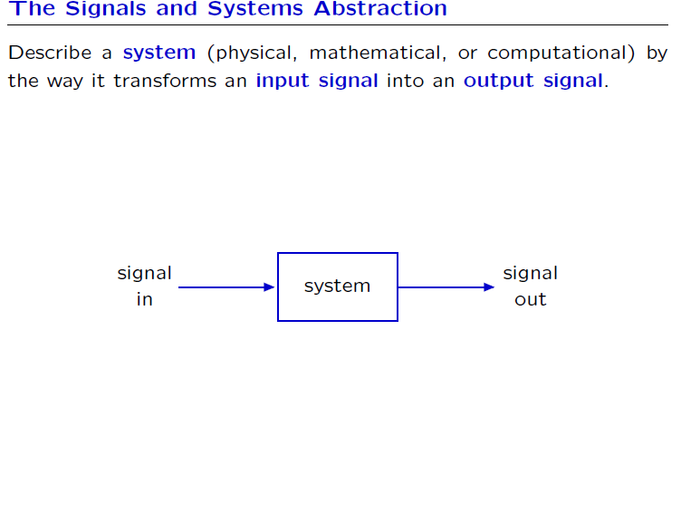

Slide 4
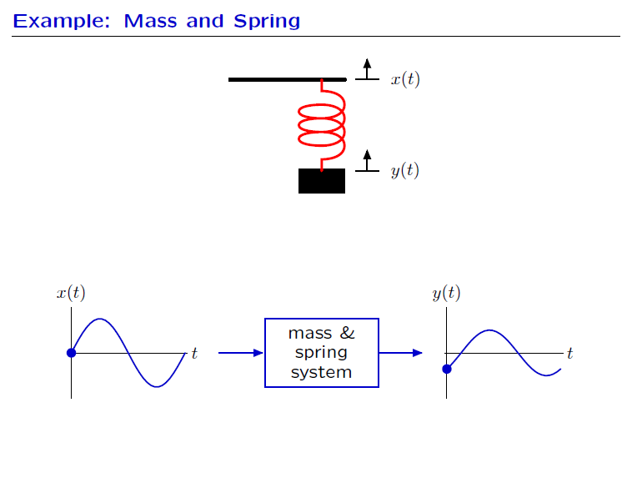

Slide 5
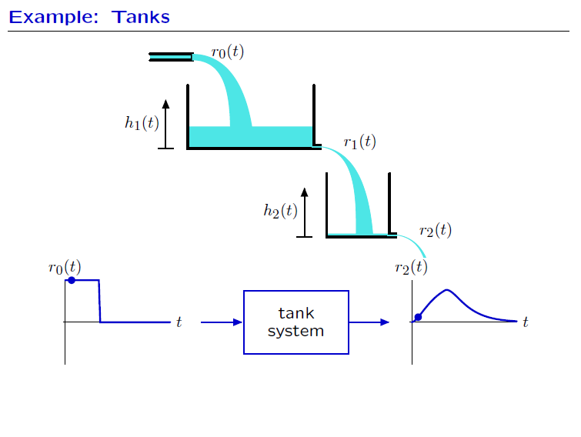

Slide 6
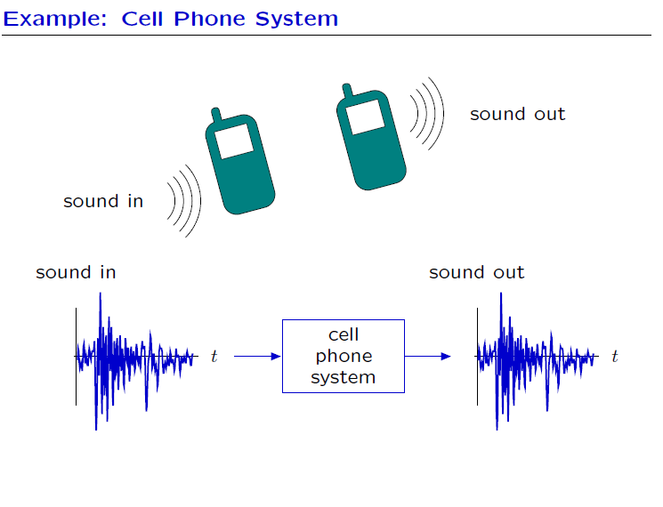

Slide 7
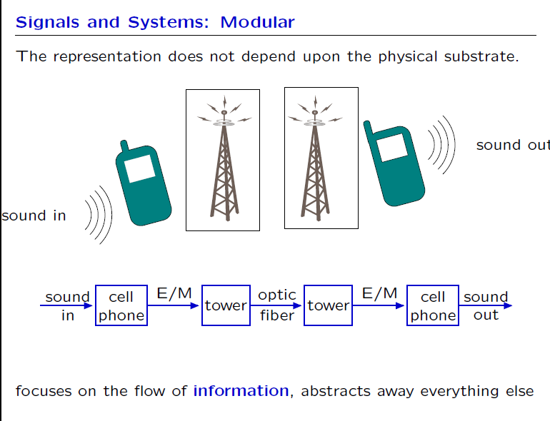

Slide 8
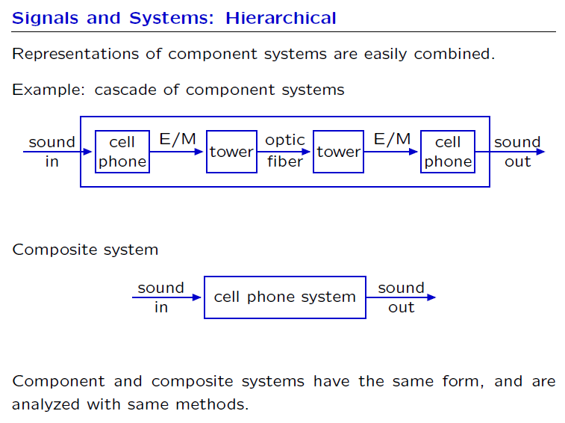

Slide 9
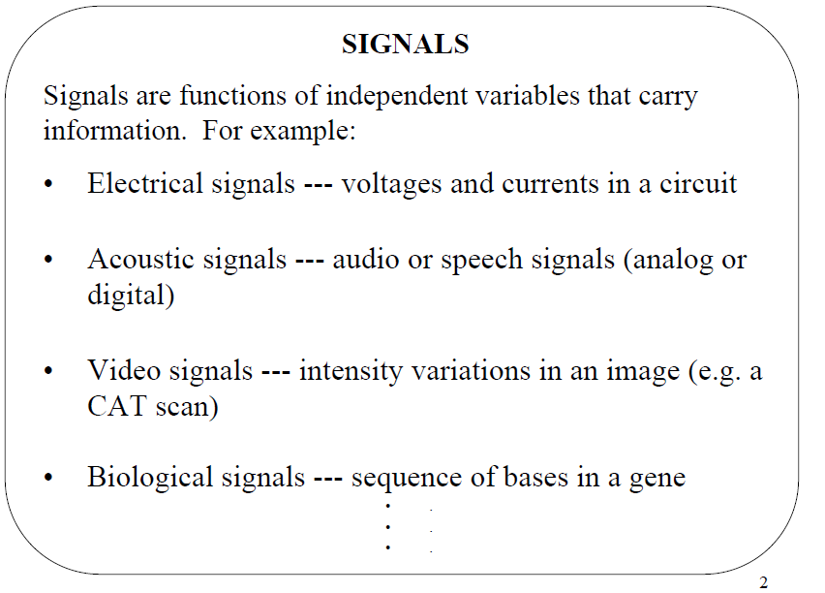

Slide 10
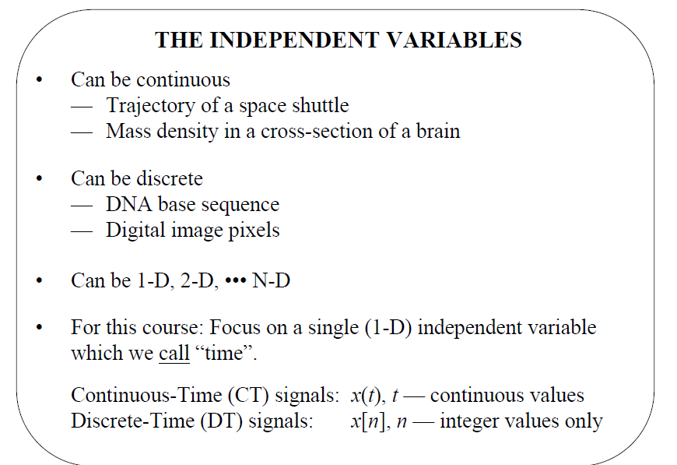

Slide 11
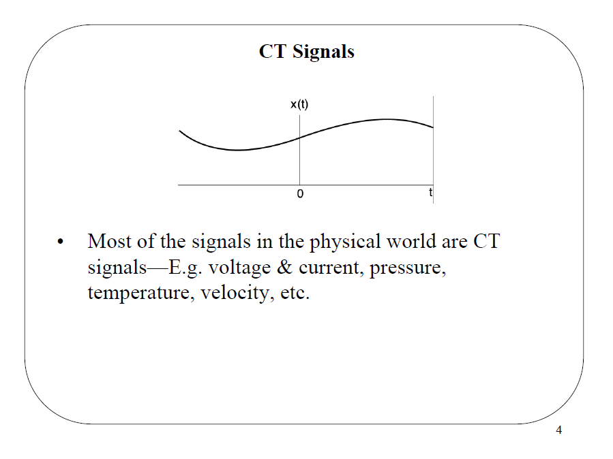

Slide 12
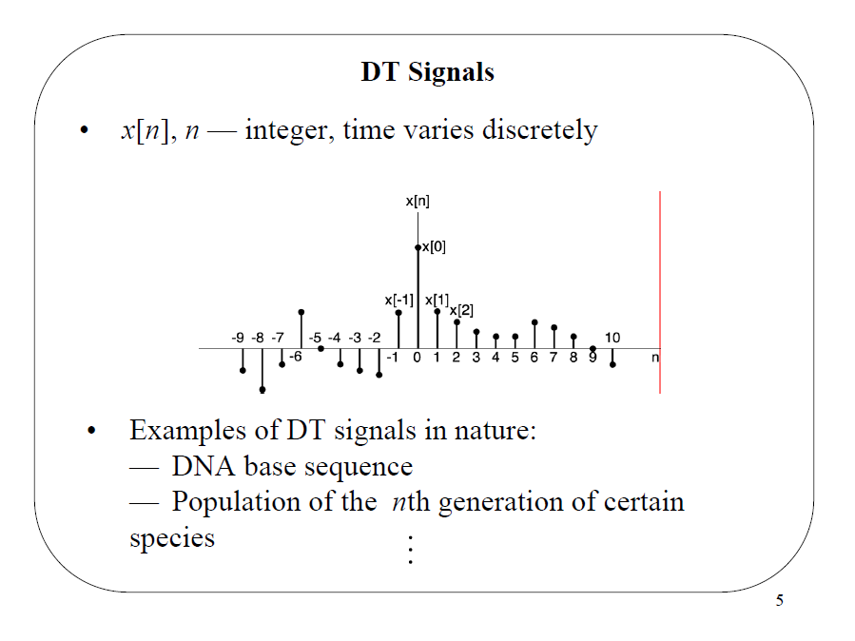

Slide 13
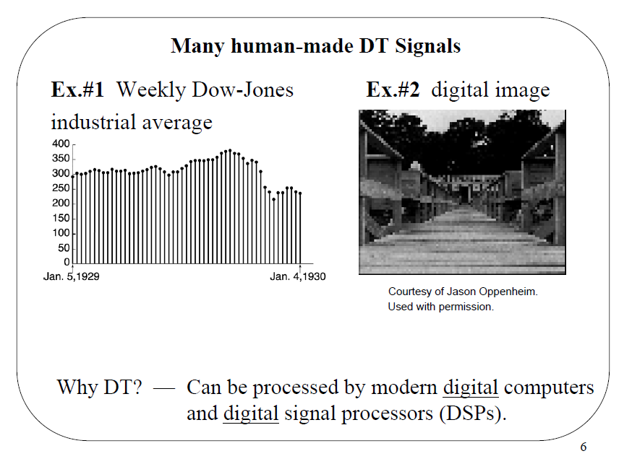

Slide 14
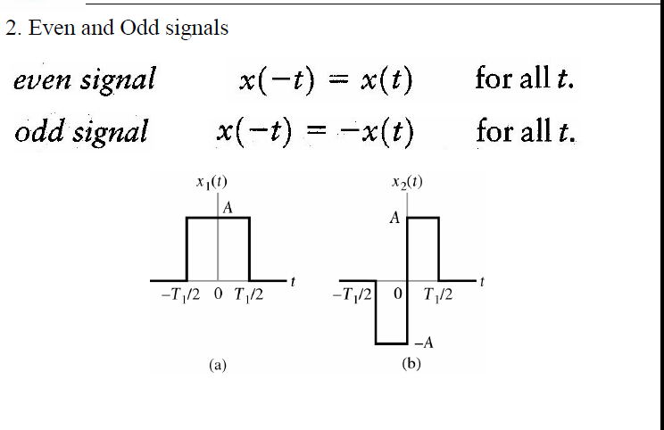

Slide 15
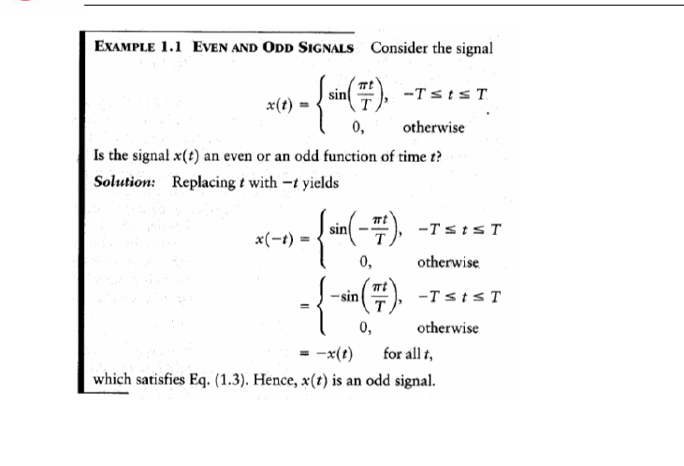

Slide 16
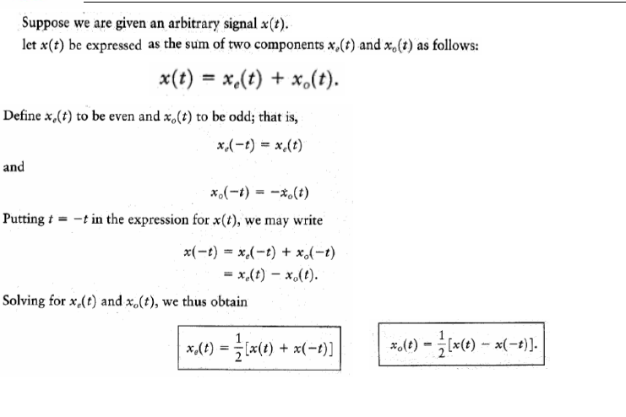

Slide 17
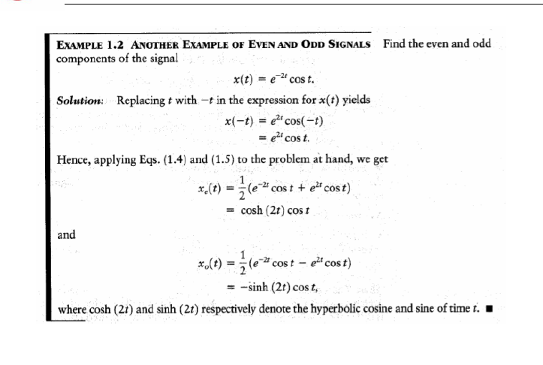

Slide 18
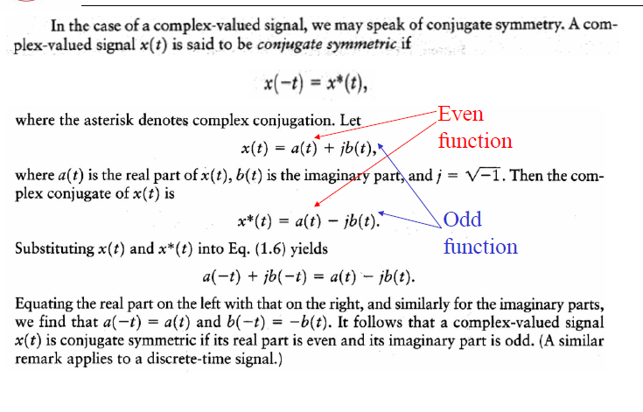

Slide 19
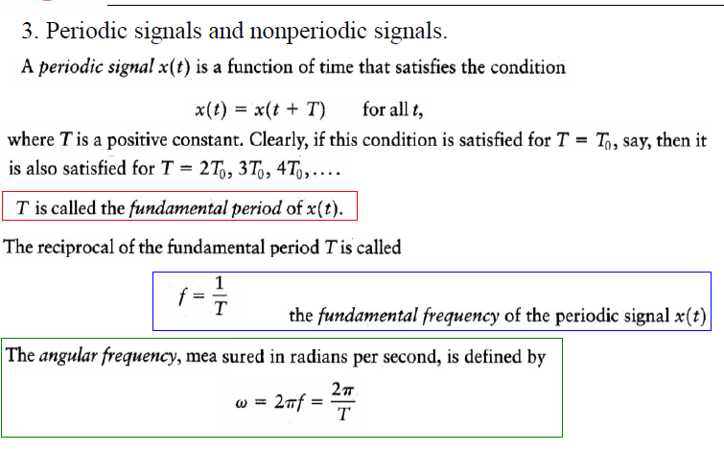

Slide 20
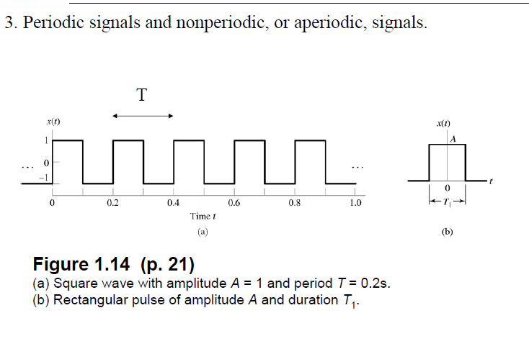

Slide 21
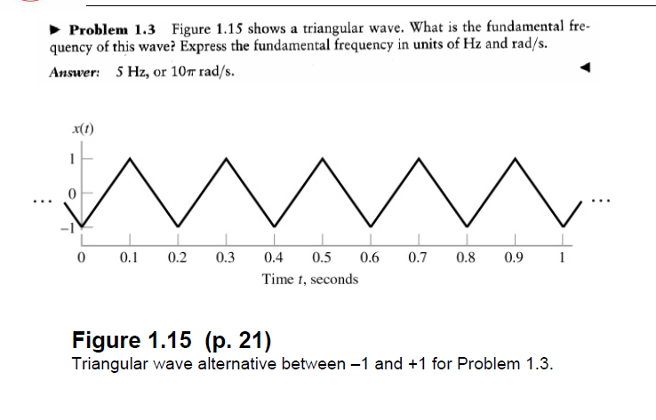

Slide 22
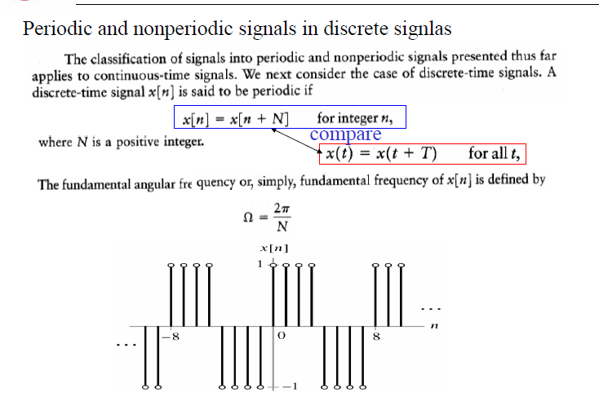

Slide 23
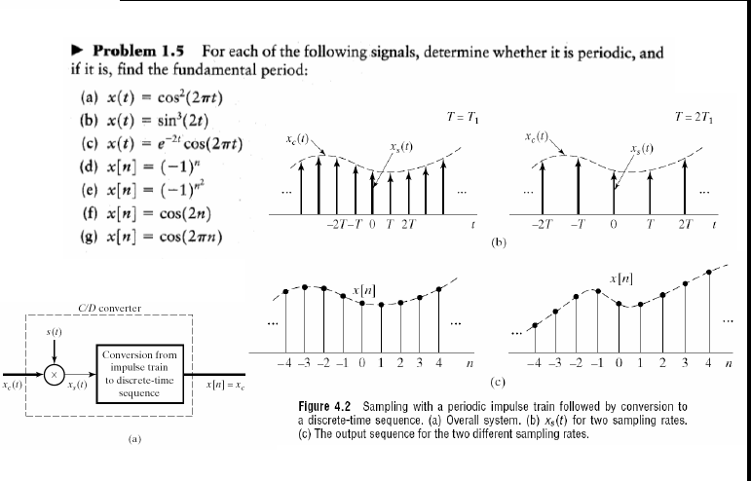

Slide 24
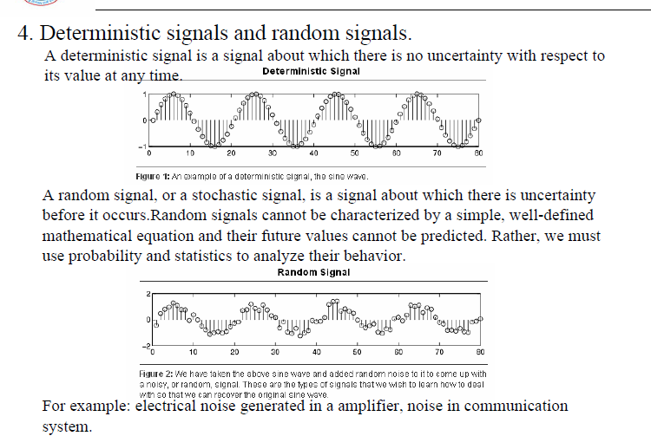

Slide 25
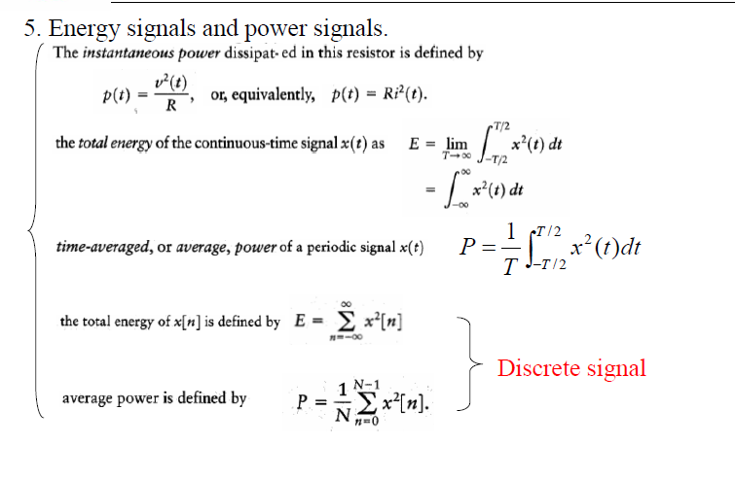

Slide 26
A signal is referred to as an energy signal if and only if the total energy of the signal satisfies the condition
0 < E < ∞
The signal is referred to as a power signal if and only if the average power of the signal satisfies the condition 0 < P < ∞
The energy and power classifications of signals are mutually exclusive. In particular , an energy signal has zero average power, whereas a power signal has infinite energy. Periodic signals and random signals are usually viewed as power signals, whereas signals that are both deterministic and aperiodic are usually viewed as energy signals.

Slide 27
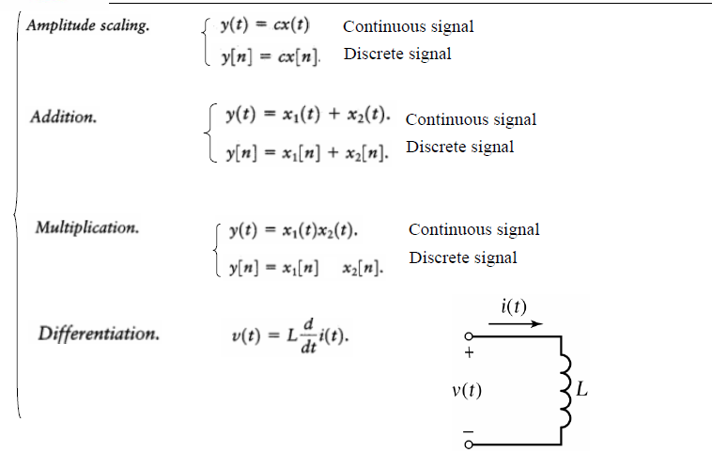

Slide 28
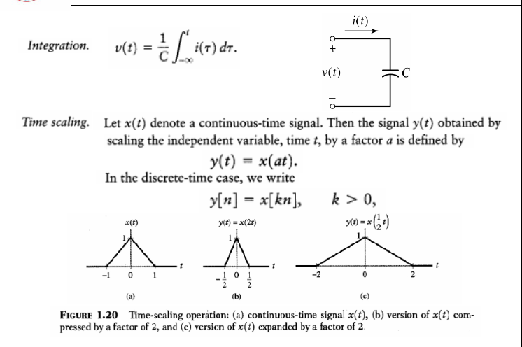

Slide 29
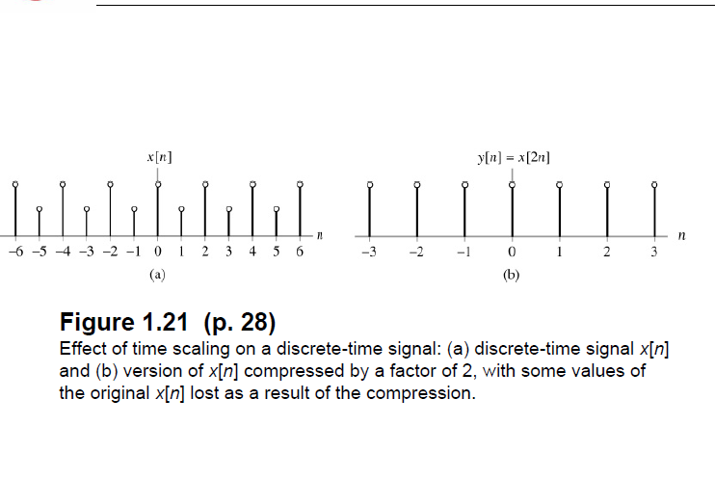

Slide 30
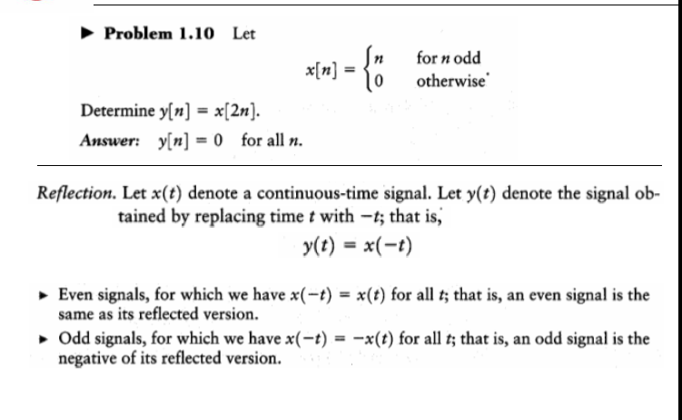

Slide 31
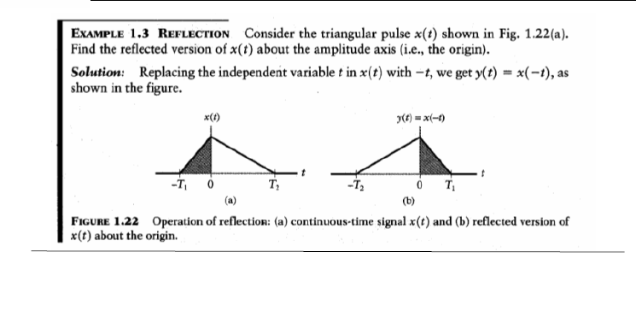

Slide 32
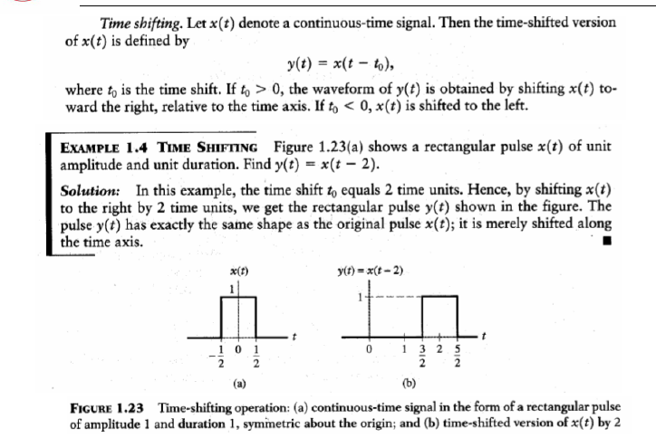

Slide 33
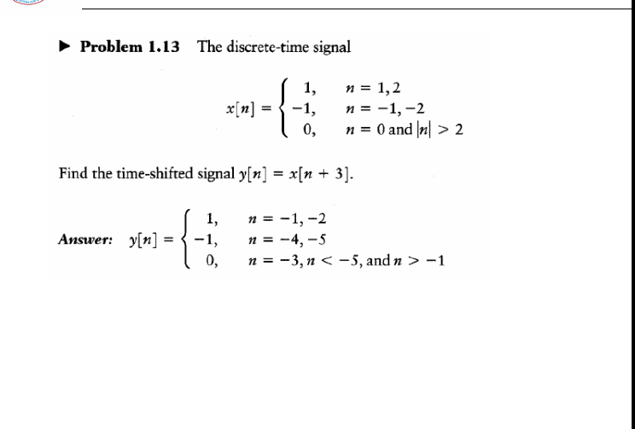

Slide 34
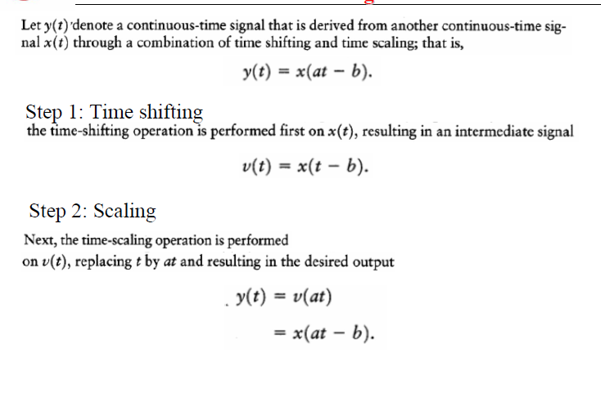

Slide 35
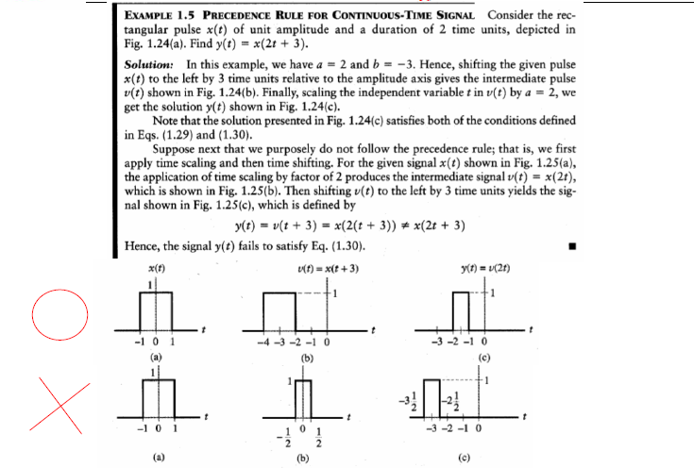

Slide 36
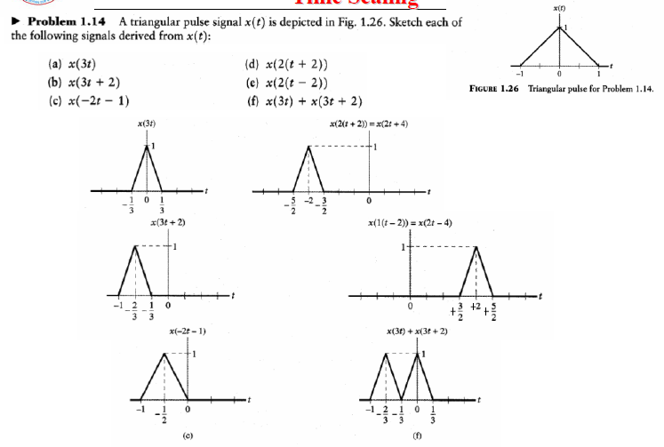

Slide 37
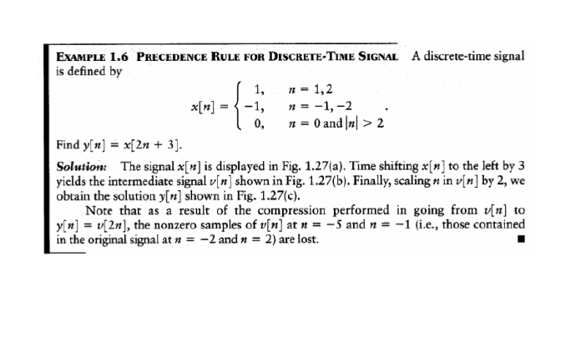

Slide 38
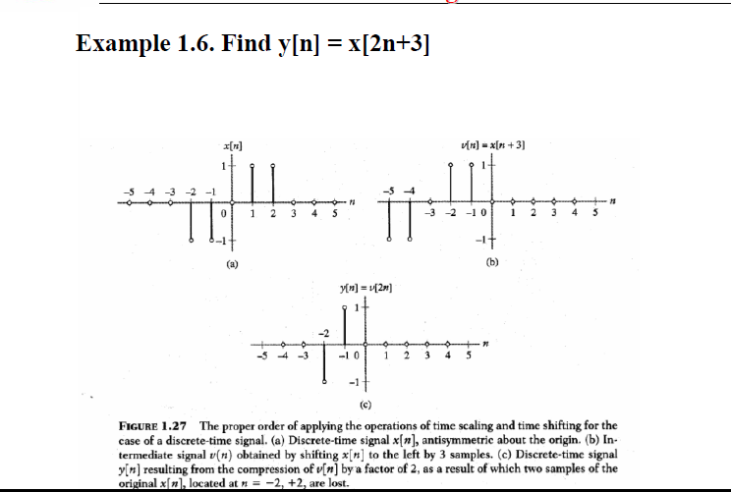

Slide 39
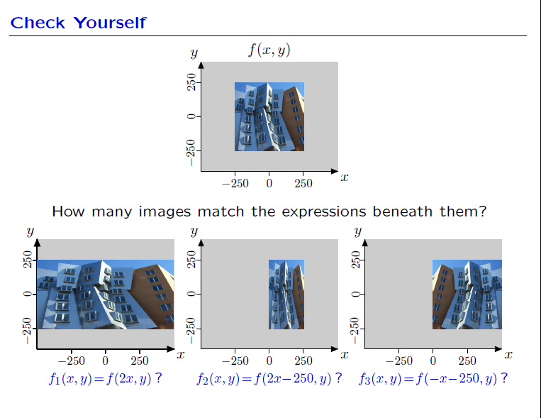

Slide 40
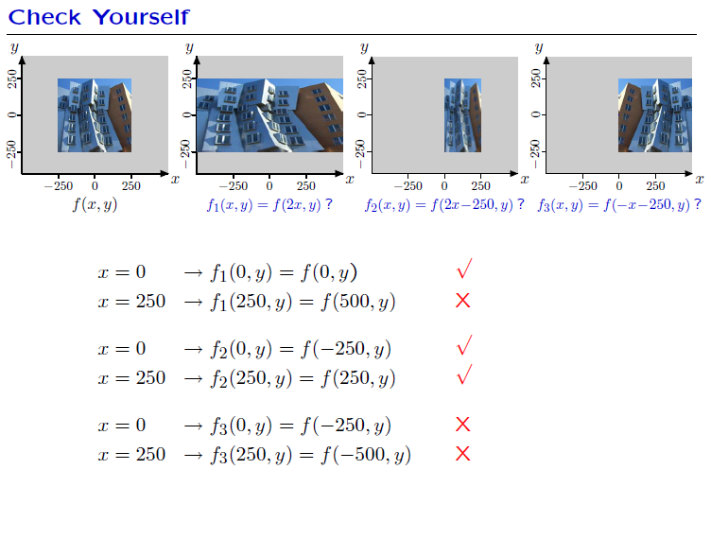

Slide 41
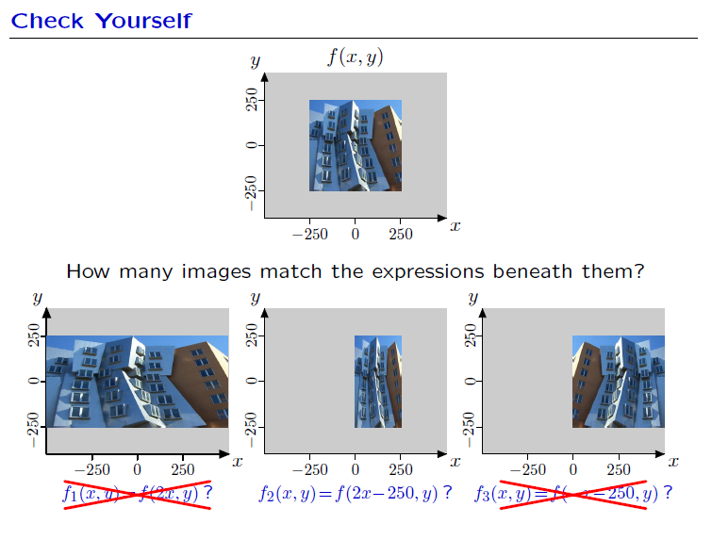

Slide 42
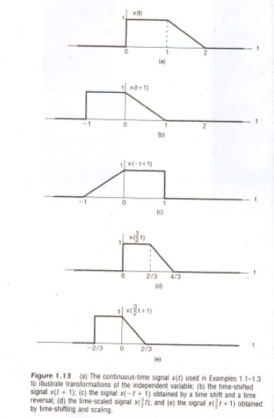

Slide 43
Elementary Signals
CT Real Exponential Signals:
B and a are real parameters
If a < 0, we have a decaying exponential
If a > 0, we have a growing exponential
If a = 0, the signal x(t) reduces to a DC signal equal to a constant B

Slide 44
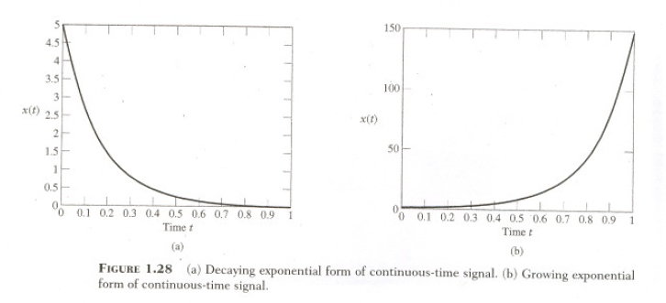

Slide 45
DT Real Exponential Signals
0 < r < 1, decaying exponential
r > 1, growing exponential
r < 0, the DT exponential signal x[n] assumes alternating signs depending on the parity of n

Slide 46
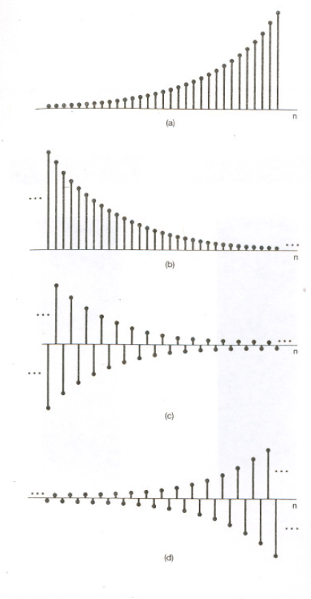

Slide 47
CT Real Sinusoidal Signals
where A is the amplitude, ω₀ is the angular frequency in radians per second, and φ is the phase angle in radians. The sinusoidal signal is a periodic signal with period T₀ given by

Slide 48
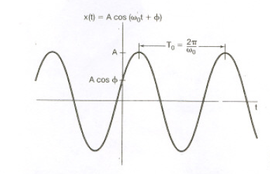

Slide 49
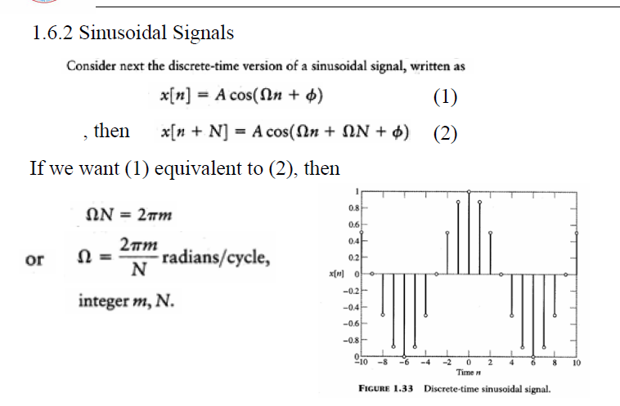

Slide 50
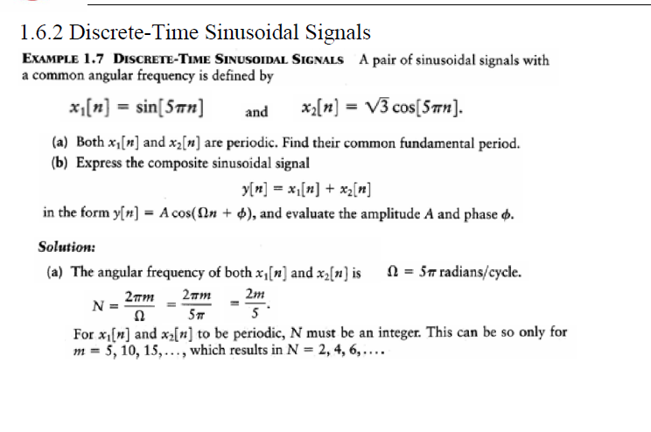

Slide 51
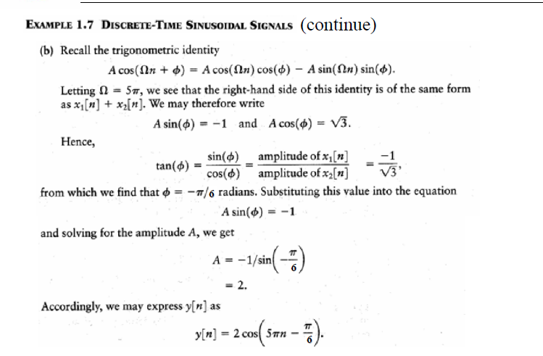

Slide 52
CT General Complex Exponential
where C and s are complex numbers
and
then
or using Euler’s identity

Slide 53
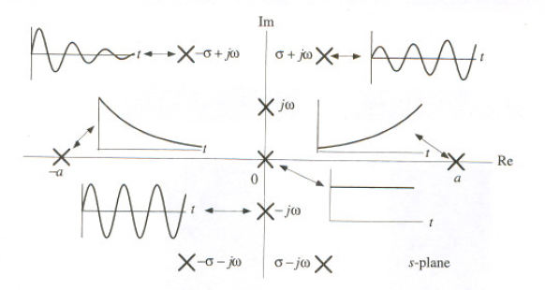

Slide 54
DT General Complex Exponential
where
and
then

Slide 55
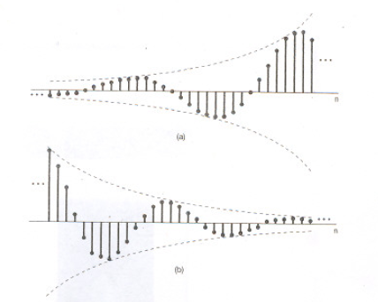

Slide 56
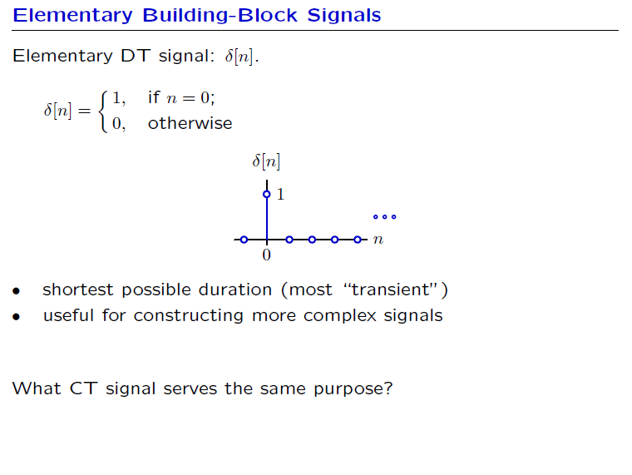

Slide 57
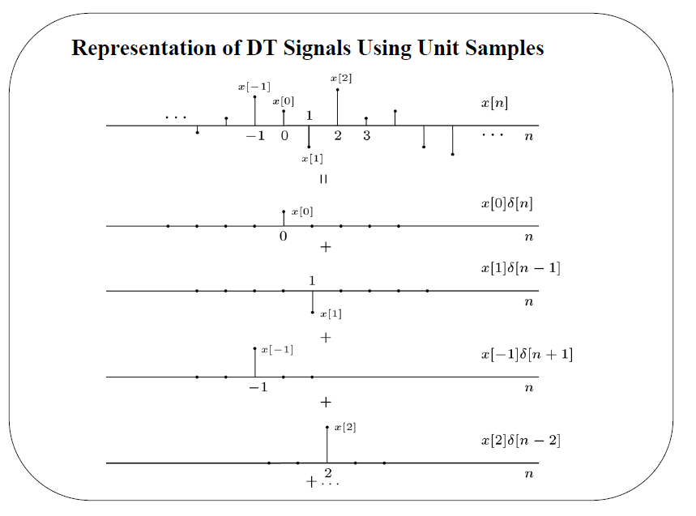

Slide 58
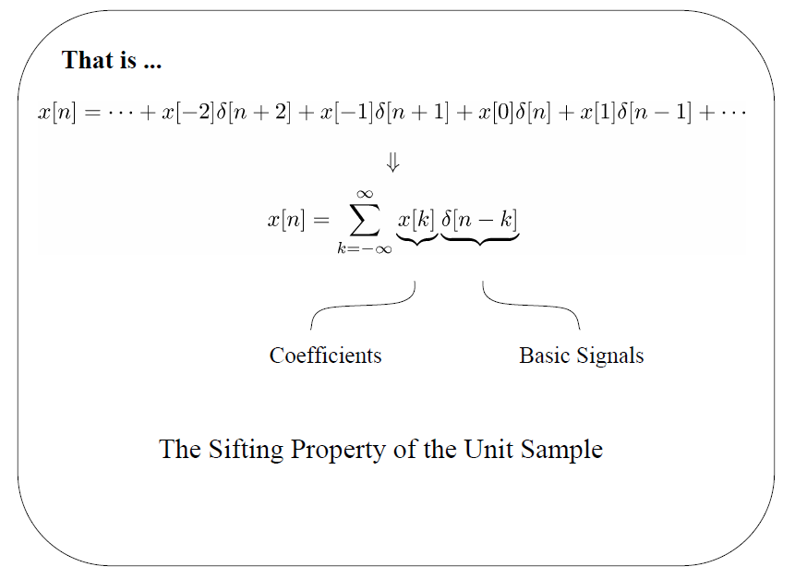

Slide 59


Slide 60


Slide 61


Slide 62


Slide 63


Slide 64


Slide 65


Slide 66


Slide 67


Slide 68


Slide 69


Slide 70


Slide 71


Slide 72


Slide 73


Slide 74

System properties

Slide 75


Slide 76


Slide 77


Slide 78


Slide 79


Slide 80


Slide 81


Slide 82


Slide 83


Slide 84


Slide 85


Slide 86


Slide 87


Slide 88


Slide 89


Slide 90


Slide 91


Slide 92


Slide 93


Slide 94
Reading assignment:
Chapter 2: sections 2.1, 2.2, and 2.3 pp 97-114

Slide 95


Slide 98


Slide 99


Slide 100


Slide 101


Slide 102


Slide 103


Slide 104


Slide 105


Slide 106


Slide 107


Slide 108


Slide 109
Reading assignment:
Chapter 2: sections 2.4, 2.5, 2.6, 2.7, and 2.8 pp 115-140

Slide 110


Slide 111


Slide 112


Slide 113


Slide 114


Slide 115


Slide 116


Slide 117


Slide 118


Slide 119


Slide 120


Slide 121


Slide 122


Slide 123


Slide 124


Slide 125


Slide 126


Slide 127


Slide 128


Slide 129
Fourier Representations of Signals and Linear Time-Invariant Systems
Reading Assignment: 3.1, 3.2,3.3, 3.5, 3.7, 3.8, 3.9,3.10, 3.11, 3.12,3.13, 3.14, 3.15, 3.16,

Slide 130


Slide 131


Slide 132


Slide 133


Slide 134


Slide 135


Slide 136


Slide 137


Slide 138


Slide 139


Slide 140


Slide 141


Slide 142


Slide 143


Slide 144


Slide 145


Slide 146


Slide 147


Slide 148


Slide 149


Slide 150


Slide 151


Slide 152


Slide 153


Slide 154


Slide 155


Slide 156


Slide 157


Slide 158


Slide 159


Slide 160


Slide 161


Slide 162


Slide 163


Slide 164


Slide 165


Slide 166


Slide 167


Slide 168


Slide 169


Slide 170


Slide 171


Slide 172


Slide 173


Slide 174


Slide 175


Slide 176


Slide 177


Slide 178


Slide 179


Slide 180


Slide 181


Slide 182


Slide 183


Slide 184


Slide 185


Slide 186


Slide 187


Slide 188


